Slide 1


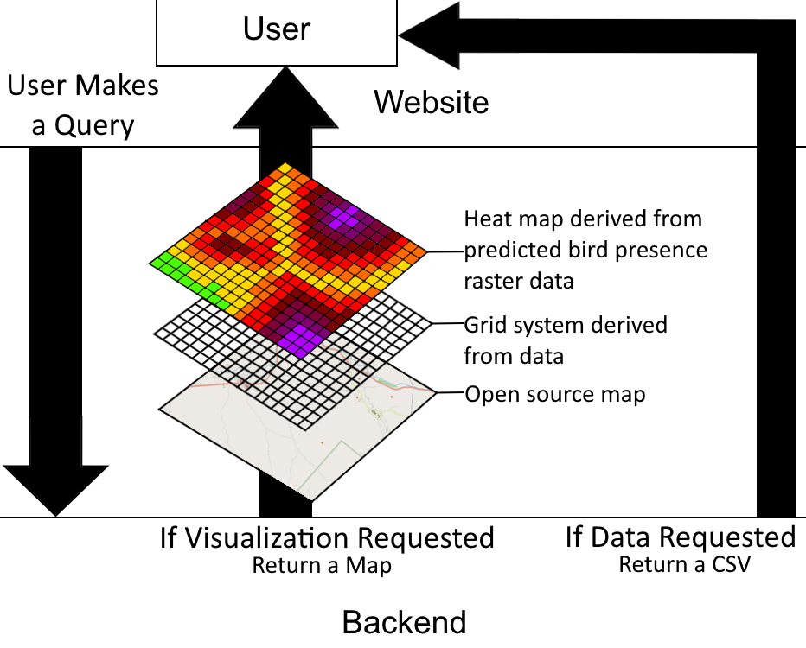
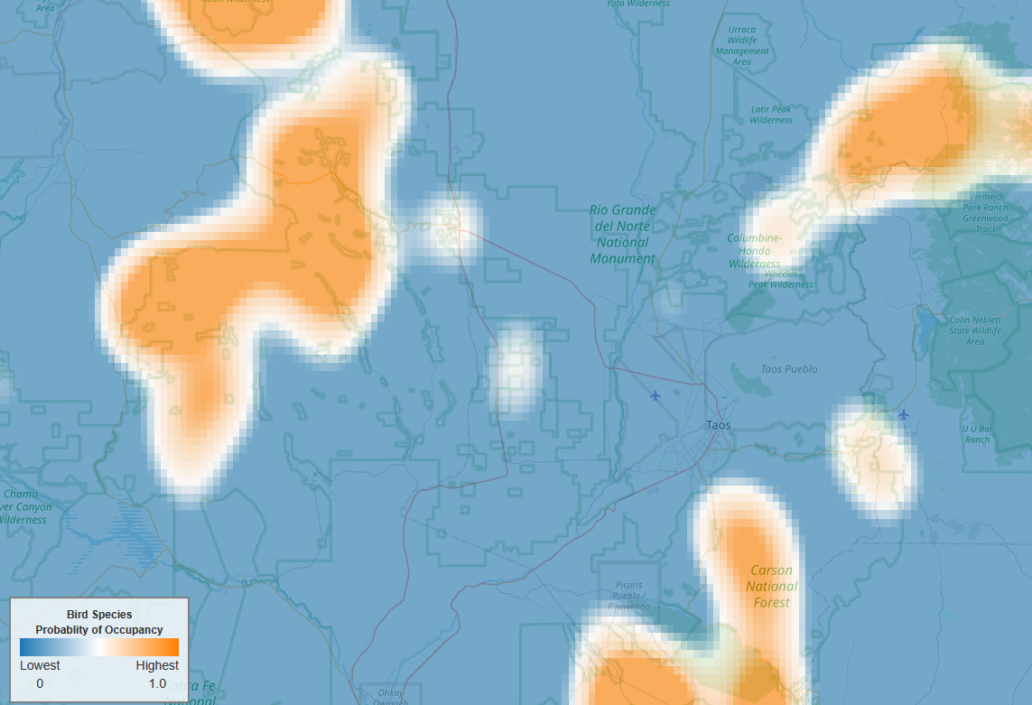
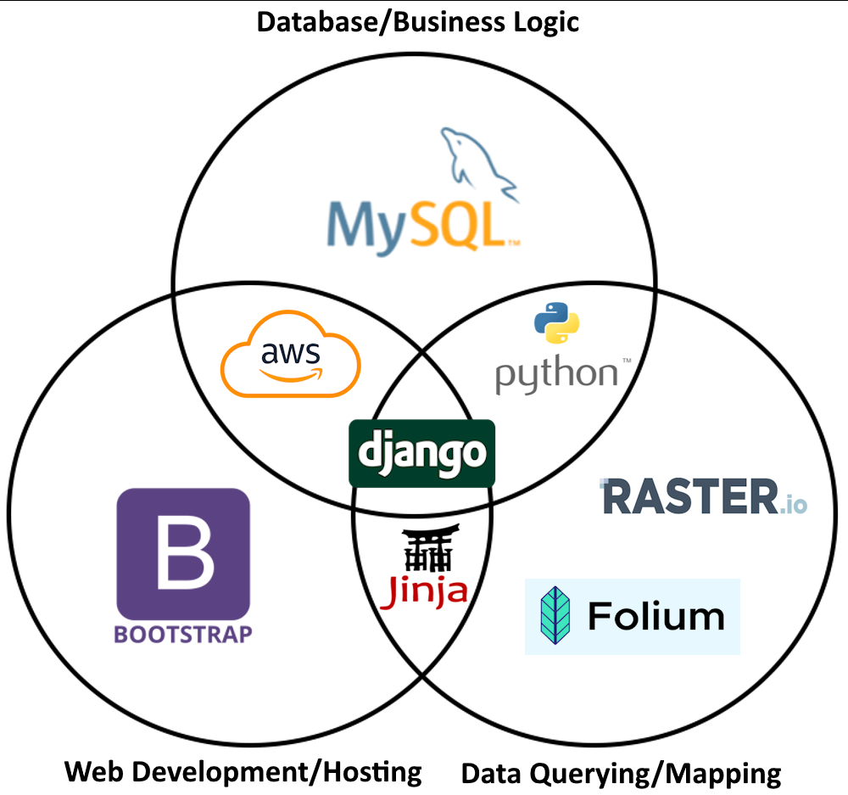

FireFlight
Team: Alyssa Ortiz (Leader), Payton Watts, Tyler Chapp, Andrew Ortega
Clients: Dr. Jamie Sanderlin, Dr. Ana Miller-ter Kuile, Dr. Kiona Ogle, USDA, US Forest Service, Northern Arizona University
Team Mentor: Scott LaRocca
What is the Problem?
Key Features
Architecture Overview
Climate change has become an increasing issue in recent years. As a result, wildfire rates have increased, ravaging ecosystems.
Birds are an indicator species that reflect an ecosystem’s health. To determine which course of actions are best to take, scientists need to first look at how bird populations will change in response to wildfires.
Currently, there is no user-friendly tool that helps visualize the predicted bird presence in an area.
Users interact with the system via the front-end, applying filters to data such as bird species.
There are two output options: a visualization of the data in the form of a heat map, and/or the data as a downloadable CSV file.
Request is sent to the back-end, retrieving data from the database, and generates a heatmap visualization.
The data & map are then returned to the website.
Map is dynamically updated and filtered data is available for download.
Data Visualization
Probability of Steller’s Jay Presence
Technologies
Solution & Impact
User-friendly visualization tool that shows predictions of bird populations based on years of gathered data.
Officials can use this tool to help estimate ecosystem recovery after wildfire or other natural disasters.
This tool will be used by US Forest Service stations across the Western US to allow prediction analysis on an individual basis and timeframe for each end user.
Visit Our Website!

